Slide 1
CSSE3113 – Introduction to Software Engineering
Software Process Models

Slide 2
Software Development
Construction
Some of the major construction activities are listed below.
Requirement Gathering
Design Development
Coding
Testing
Management
Some of the major management activities are listed below.
Project Planning and Management
Configuration Management
Software Quality Assurance
Installation and Training

Slide 3
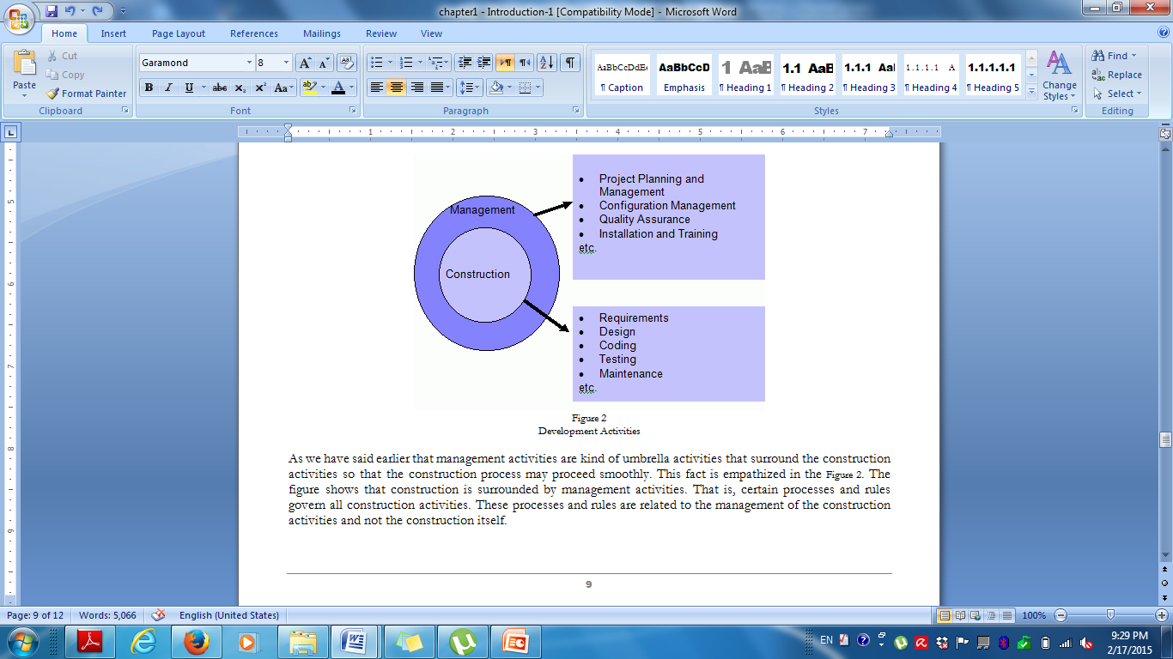
Figure 1: Development Activities

Slide 4
Ad hoc Software Development
Developing software without planning for each phase, and without specifying tasks, deliverables, or time constraints.
Relies entirely on the skills and experience of the individuals performing the work.
The software process may change as work progresses.

Slide 5
Case Study : SaudiTech
What could go wrong in a software development project?
SaudiTech is a software company. It has a team of 25 programmers. Ali has recently established a dental clinic in Riyadh and asked SaudiTech to develop a management system for his dental clinic.
Ali’s request was to develop a system to electronically manage patient records and perform administrative functions similar to ‘what is being used in other clinics’ but within a budget of 500 Saudi riyals and delivered within 3 months.
SaudiTech adopts an ad hoc approach (Developing software without planning for each phase, and without specifying tasks, deliverables, or time constraints) to software development and has not worked on large scale projects before.
What problems do you anticipate in this project?

Slide 6
How can we overcome problems with ad hoc software development?
Problems:
Difficult to distinguish between tasks → important tasks may be ignored.
Inconsistent schedules, budgets, functionality and product quality.
Delayed problem discovery → more costly to fix.
Software Process Models provide guidelines to organize how software process activities should be performed and in what order.
Solution? Software Process Model

Slide 7
The Software Process
A structured set of activities required to develop a software system.
Many different software processes but all involve:
Specification – defining what the system should do
Design and implementation – defining the organization of the system and implementing the system;
Validation – checking that it does what the customer wants;
Evolution – changing the system in response to changing customer needs.
A software process model is an abstract representation of a process. It presents a description of a process from some particular perspective.

Slide 8
Software Process Descriptions
When we describe and discuss processes, we usually talk about the activities in these processes such as specifying a data model, designing a user interface, etc. and the ordering of these activities.
Process descriptions may also include:
Products, which are the outcomes of a process activity;
Roles, which reflect the responsibilities of the people involved in the process;
Pre- and post-conditions, which are statements that are true before and after a process activity has been enacted or a product produced.

Slide 9
Plan-driven and Agile Processes
Plan-driven processes are processes where all of the process activities are planned in advance and progress is measured against this plan.
Plan drives everything!
In Agile Processes planning is incremental and it is easier to change the process to reflect changing customer requirements.

Slide 10
Plan-driven and Agile Processes
Activity
Research and list two advantages and two disadvantages of both Plan-Driven and Agile processes.

Slide 11
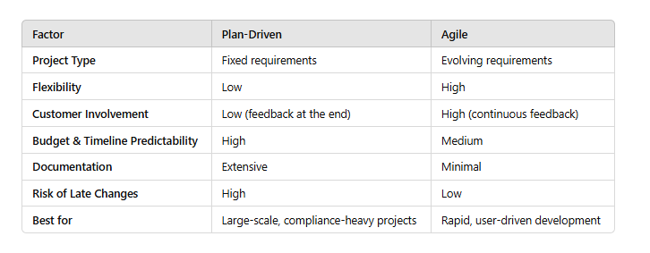
Plan-driven and Agile Processes
In practice, most practical processes include elements of both plan-driven and agile.
There are no right or wrong software processes.

Slide 12
Software Process/SDLC Models
Software Process model:
Abstract representation of a software process
Each Process model represents a process from different perspective
Following are the most important and popular SDLC models followed in the industry:
Waterfall model.
V Model
Evolutionary development.
Component-Based development model (CBSE).
Process iteration(incremental and spiral Models)
The other related methodologies are Agile and RAD Model – Rapid Application Development

Slide 13
Waterfall Model
First published model
Because of the cascade from one phase to another, this model is known as ‘Waterfall Model’.
It is also referred to as linear-sequential life cycle model.
Each phase must be completed before the next phase can begin and there is no overlapping in the phases.

Slide 14
Waterfall Model
The sequential phases in Waterfall model are:
Requirement Gathering and analysis: All possible requirements of the system to be developed are captured in this phase and documented in a requirement specification document.
System’s services
Constraints
Goals
System Design: The requirement specifications from first phase are studied in this phase and system design is prepared. System Design helps in specifying hardware and system requirements and also helps in defining overall system architecture.

Slide 15
Waterfall Model
Implementation and unit testing: With inputs from system design, the system is first developed in small programs called units, which are integrated in the next phase. Each unit is developed and tested for its functionality which is referred to as Unit Testing.
Integration and Testing: All the units developed in the implementation phase are integrated into a system after testing of each unit. Post integration the entire system is tested for any faults and failures.

Slide 16
Waterfall Model
Deployment of system: Once the functional and nonfunctional testing is done, the product is deployed in the customer environment or released into the market.
Maintenance: There are some issues which come up in the client environment. To fix those issues patches are released. Also, to enhance the product some better versions are released. Maintenance is done to deliver these changes in the customer environment.

Slide 17
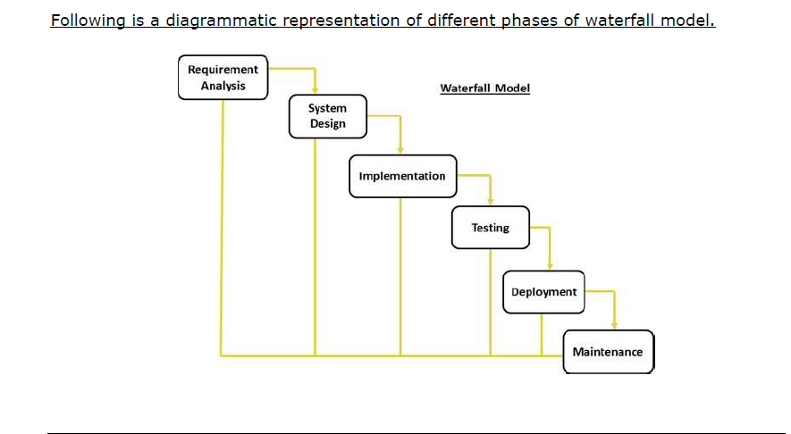
Waterfall Model

Slide 18
Waterfall Model
Applicability:
Requirements are very well understood, clear and fixed
Product definition is stable
Technology is understood

Slide 19
Waterfall Model
Advantages:
Documentation - at each phase
Phases are processed and completed one at a time.
Easy to arrange tasks.
Problems:
Inflexible partitioning of the project into distinct stages makes it difficult to respond to changing customer requirements.

Slide 20
V Model
A variation of the waterfall model
Development phases are presented in a V-shaped graph.
It is also known as Verification and Validation model.
For every single phase in the development cycle there is a directly associated testing phase.

Slide 21
Verification and Validation
Verification
Does the product meet system specifications?
Have you built the product right?
Validation
Does the product meet user expectations?
Have you built the right product?

Slide 22
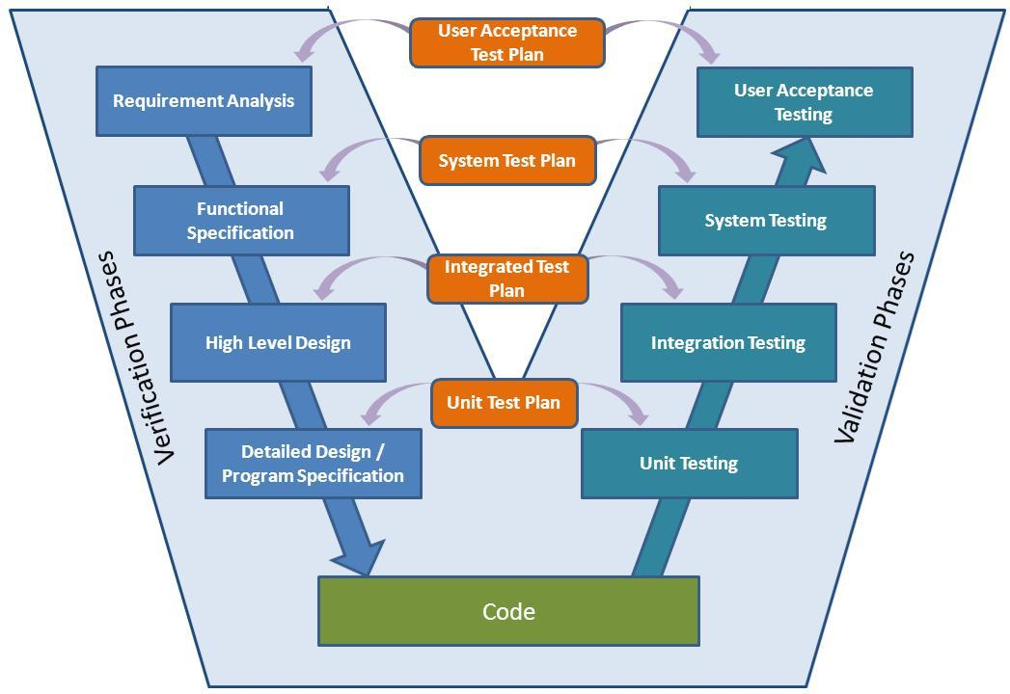
V Model

Slide 23
V Model Verification Phases
Following are the Verification phases in V-Model
Business Requirement Analysis:
This phase involves detailed communication with the customer to understand his expectations and exact requirement.
The acceptance test design planning is done at this stage as business requirements can be used as an input for acceptance testing.
System Design:
System design would comprise of understanding and detailing the complete hardware and communication setup for the product under development.
System test plan is developed based on the system design.

Slide 24
V Model Verification Phases
Architectural Design:
System design is broken down further into modules taking up different functionality.
The data transfer and communication between the internal modules and with the outside world (other systems) is clearly understood and defined in this stage.
With this information, integration tests can be designed and documented during this stage.
Module Design:
In this phase the detailed internal design for all the system modules is specified
It is important that the design is compatible with the other modules in the system architecture and the other external systems.
Unit tests can be designed at this stage

Slide 25
V Model
Coding Phase
The actual coding of the system modules designed in the design phase is taken up in the Coding phase.
The best suitable programming language is decided based on the system and architectural requirements.
The coding is performed based on the coding guidelines and standards.
The code goes through numerous code reviews and is optimized for best performance before the final build is checked into the repository.

Slide 26
V Model Validation Phases
Following are the Validation phases in V-Model:
Unit Testing:
Unit tests designed in the module design phase
Unit testing is the testing at code level and helps to eliminate bugs at an early stage
Integration Testing:
Integration testing is associated with the architectural design phase.
Integration tests are performed to test the coexistence and communication of the internal modules within the system.

Slide 27
V Model Validation Phases
System Testing:
System tests check the entire system functionality and the communication of the system under development with external systems.
Most of the software and hardware compatibility issues can be uncovered during system test execution.
Acceptance Testing:
Acceptance testing is associated with the business requirement analysis phase and involves testing the product in user environment.
It also discovers the non functional issues such as load and performance defects in the actual user environment.

Slide 28
V Model
Advantages:
Testing activities like planning, test designing, happens well before coding.
Higher chances of success over the waterfall model.
Works well for projects where requirements are easily understood.
Problems:
Difficult to handle changes in requirements throughout the life cycle

Slide 29
V Model
Applicability:
The V-shaped model should be used for projects where requirements are clearly defined and fixed.
The V-Shaped model should be chosen when technical resources are available with needed technical expertise.
High confidence of customer is required for choosing the V-Shaped model approach.

Slide 30
Evolutionary Models
Evolutionary Development:
Includes the activities of specification, development and validation
Initial system is developed from abstract specification
Then refined with customer input to produce a system that satisfies the customer’ s needs.
Two types of evolutionary development
Exploratory
Prototyping

Slide 31
Evolutionary Models
Exploratory Model
Objective of the process is to work with customers to explore their requirements and deliver a final system.
The development starts with the parts of the system that are understood.
The system evolves by adding new features proposed by customer.
This model works best in situations where few, or none, of the system or product requirements are known in detail.

Slide 32
Exploratory Models
Specification
Initial Version
Outline Description
Intermediate Version
Development
Validation
Final
Version

Slide 33
Exploratory Model
Problems:
Lack of process visibility;
Systems are often poorly structured
Applicability:
For small or medium-size interactive systems
For parts of large systems (e.g. the user interface)

Slide 34
Evolutionary Models
Prototyping Model
When a customer defines a set of general objectives for a software but does not identify detailed I/O or processing requirements.
A prototype is built to understand the requirements.
By using this prototype, the client can get an “actual feel” of the system
The interactions with prototype can enable the client to better understand the requirements of the desired system
Prototyping is an attractive idea for complicated and large systems.

Slide 35
Evolutionary Models
Prototyping Model
Consists of 4 iterating phases:
Requirements gathering.
Design and build prototype.
Evaluate prototype with customer.
Refine requirements.

Slide 36
Prototype Model
1. Requirements gathering.
2. Design and build SW prototype.
3. Evaluate prototype with customer.
4. Refine requirements.
1 / 4
Listen to Customer
2
Build / Revise prototypes
3
Customer Test-Drives prototypes

Slide 37
Prototyping
Engineer
Product
Requirements
No
Quick
Design
Yes
Changes?
Build
Prototype
Refine
Prototype
Evaluate
Prototype
(Pressman, 1996)

Slide 38
Prototype Model
Advantages:
Users are actively involved in the development
Users get a better understanding of the system being developed.
Errors can be detected much earlier.
Quicker user feedback is available leading to better solutions.
Disadvantages:
Practically, this methodology may increase the complexity of the system as scope of the system may expand beyond original plans.

Slide 39
Prototype Model
Applicability:
Prototype model should be used when the desired system needs to have a lot of interaction with the end users.
Typically, online systems, web interfaces have a very high amount of interaction with end users, are best suited for Prototype model.

Slide 40
Component-based Software Engineering
Based on systematic reuse where systems are integrated from existing components.
People working on the project → Know of design or code (similar to that required)→ Modify them as needed → incorporate them into their system
Process stages
Component analysis
Requirements modification
System design with reuse
Development and integration
This approach is becoming increasingly used

Slide 41
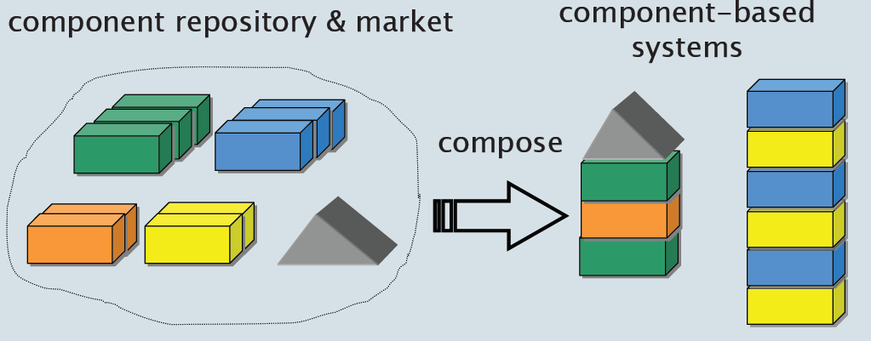
The CBD/CBSE is the Solution…
Systems should be assembled from existing components

Slide 42
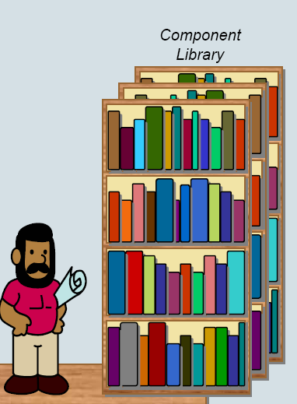
Why Components!!!
Following other engineering disciplines (civil and electrical), software engineering is looking to develop
A catalogue of software building blocks
Connection Standards

Slide 43
Component-based Software Engineering

Slide 44
Component-based Software Engineering
Component analysis
Given the requirement specification
Search is made for components
Usually there is no exact match.
Requirement Modification
Requirements are analyzed—using information of discovered components
If modifications are impossible— component analysis activity may be re-entered to search for alternate solution
System Design with Reuse
Frame work of system is designed or an existing frame work is reused.
Development and integration Software
Existing software /modified and newly developed components are integrated.

Slide 45
Component-based Software Engineering
Advantages
Reduce the amount of software to be developed
Reducing cost and risk
Faster delivery of software
Disadvantages
Requirement changes—may lead to a system that does not meet the real needs of users
Control over the system evolution is lost

Slide 46
Process Iteration
Two (related) process models
Incremental delivery
Spiral development

Slide 47
Incremental Approach
“The software specification, design and implementation are broken down into a series of increments that are each developed in turn”
System development is decomposed into increments and each delivers a proportion of the system.
Increments are developed based on their requirement priorities.

Slide 48
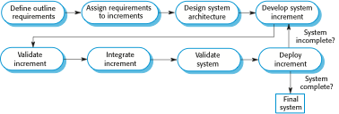
Incremental Development

Slide 49
Incremental Delivery(Steps)
Customer identify—services provided by the system
Then identify which of the services are most important and which are least important
No of delivery increments are then identified with sub-set of the system functionality
Highest priority services delivered first
Requirements for the first increment are defined in detail
First Increment is developed and delivered ..customer can put into service.(Benefit for customer?)
During development ….further requirements analysis for later increments can take place

Slide 50
Incremental Model
Advantages:
Customer value can be delivered with each increment so system functionality is available earlier.
Early increments act as a prototype to help elicit requirements for later increments.
Lower risk of overall project failure.
The highest priority system services tend to receive the most testing.
Disadvantages:
Can be difficult to map the customer’s requirements onto increments of the right size.
Hard to identify common functions.

Slide 51
Spiral Model
The software process is represented as spiral, rather than a sequence of activities with some backtracking from one activity to another.
Each loop in spiral represents a phase of the software process
Innermost loop might be concerned with system feasibility
Next loop with requirements definition…next with system designed and so on.

Slide 52
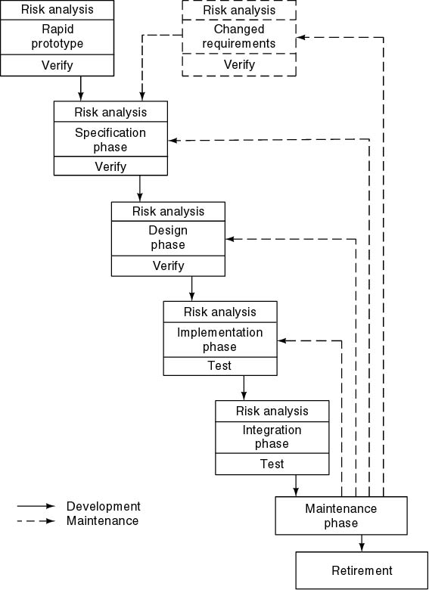
Spiral Model
Simplified form
Waterfall model plus risk analysis
Precede each phase by
Alternatives (build, reuse, buy, sub-contract)
Risk analysis (lack of experience, new technology, tight schedules)
Follow each phase by
Evaluation
Planning of next phase

Slide 53
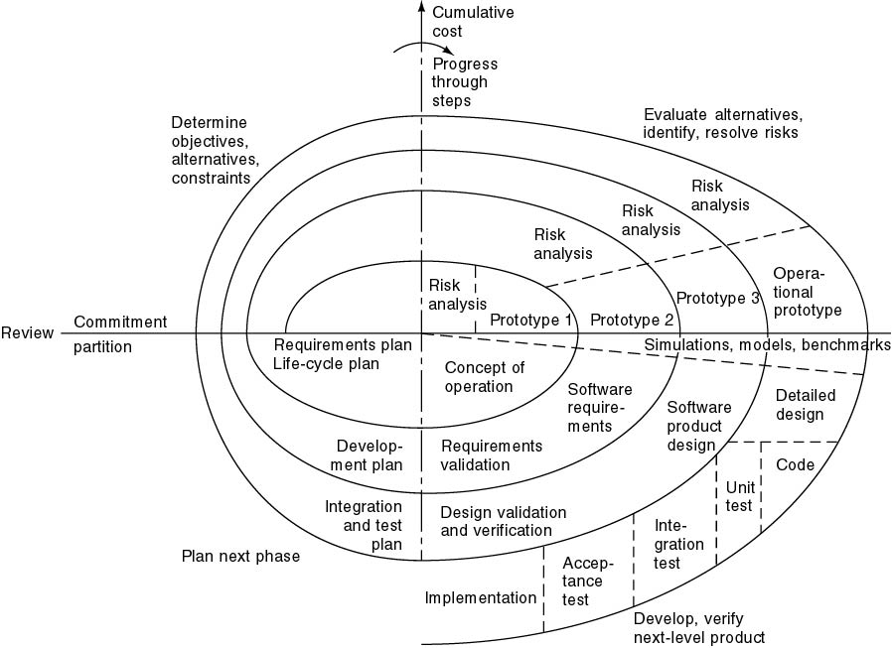
Full Spiral Model
If risks cannot be resolved, project is immediately terminated
Typical activates:
Create a design
Review design
Develop code
Inspect code
Test product

Slide 54
Spiral Model of the Software Process

Slide 55
Spiral Model Sectors
Each loop in spiral is split into four sectors
Objective setting
Specific objectives for that phase of the project are identified
Identify Constraints → on process & product.
Detail management plan is drawn up
Identify Project risks
Alternative strategies on these risks ...may be planned

Slide 56
Spiral Model Sectors
Risk assessment and reduction
For every identified risk → Detailed analysis is carried out
Steps are taken to reduce the risk
E.g.
Risk :
Requirements are inappropriate
Solution / Strategy
A prototype system may be developed
* Risks are
poorly understood requirements
poorly understood architecture
performance problems
important missing features

Slide 57
Spiral Model Sectors
Development and validation
A development model for the system is chosen which can be any of the generic models
For example, if user interface risks are dominant, an appropriate model may be “Evolutionary Prototyping”.
Selection of model will depend on your risk analysis.
Planning
The project is reviewed
Decision made whether to continue with a further loop of the spiral
If decided to continue, the next phase of the spiral is planned

Slide 58
Spiral Model(Example)
The evolution of Microsoft Operating System, Compilers and other operating systems.

